Slide 1
ANDROID UI
Nilanjan Banerjee, Associate Professor, Computer Science and Electrical Engineering

Slide 2
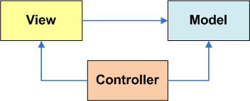
The Model-View-Control (MVC) Pattern
The Model-View-Controller (MVC) is an important software design pattern whose main goal is to separate the (1) user interface, (2) business, and (3) input logic.
How is this seen by the Android developer?
Model. Consists of the Java code and objects used to manage the behavior and data of the application.
View. Set of screens the user sees and interacts with.
Controller. Implemented through the Android OS, responsible for interpretation of the user and system inputs. Input may come from a variety of sources such as the trackball, keyboard, touchscreen, GPS chip, background services, etc, and tells the Model and/or the View (usually through callbacks and registered listeners) to change as appropriate.
22
[Burbeck92] Burbeck, Steve. "Application Programming in Smalltalk-80: How to use Model-View-Controller (MVC)."University of Illinois in Urbana-Champaign (UIUC) Smalltalk Archive. Available at: http://st-www.cs.illinois.edu/users/smarch/st-docs/mvc.html.

Slide 3
The Model-View-Control (MVC) Pattern
Getting ready to create MVC conforming solutions
The Android developer should be aware of …
Inputs could be sent to the application from various physical/logical components. Reacting to those signals is typically handled by callback methods. Usually there are many of them, you want to learn how to choose the appropriate one.
Moving to states in the lifecycle is tied to logic in the model. For instance, if forced to Pause you may want to save uncommitted data.
A notification mechanism is used to inform the user of important events happening outside the application (such as arrival of a text message or email, phone calls, etc) and consequently choose how to proceed.
Views are unlimited in terms of aesthetic and functionality. However physical constraints such as size, and hardware acceleration (or lack
of) may affect how graphical components are managed.
3

Slide 4
Android & the MVC Pattern
The View - User Interfaces (Uis)
Android graphical interfaces are usually implemented as XML files (although
they could also be dynamically created from code).
An Android UI is conceptually similar to a common HTML page
In a manner similar to a web page interaction, when the Android user touches the screen, the controller interprets the input and determines what specific portion of the screen and gestures were involved. Based on this information it tells the model about the interaction in such a way that the appropriate “callback listener” or lifecycle state could be called into action.
Unlike a web application (which refreshes its pages after explicit requests from the user) an asynchronous Android background service could quietly notify the controller about some change of state (such as reaching a given coordinate on a map) and in turn a change of the view’s state could be triggered; all of these without user intervention.
4

Slide 5
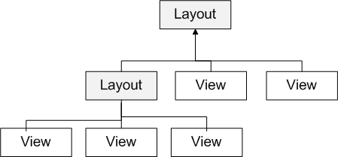
The View Class
The View class is the Android’s most basic component from which users interfaces
can be created. This element is similar to the Swing JComponent class for Java apps.
A View occupies a rectangular area on the screen and is responsible for drawing and event handling.
Widgets are subclasses of View. They are used to create interactive UI components such as buttons, checkboxes, labels, text fields, etc.
Layouts are invisible containers used for holding other Views and nested layouts.
6

Slide 6
Using Views
An Android’s XML view file consists of a layout holding a hierarchical arrangement of its contained elements.
The inner elements could be simple widgets or nested layouts holding some complex viewgroups.
An Activity uses the setContentView(R.layout.xmlfilename)
method to render a view on the device’s screen.
<?xml version="1.0" encoding="utf-8"?>
<LinearLayout
xmlns:android="http://schemas.android.com/apk/res/android" android:layout_width="fill_parent" android:layout_height="fill_parent" android:orientation="horizontal" >
Widgets and other nested layouts
</LinearLayout>
8

Slide 7
Using Views
Dealing with widgets & layouts typically involves the following operations
Set properties: For example setting the background color, text, font and size of a TextView.
Set up listeners: For example, an image could be programmed to respond to various events such as: click, long-tap, mouse-over, etc.
Set focus: To set focus on a specific view, you call the method requestFocus() or use XML tag <requestFocus />
Set visibility: You can hide or show views using setVisibility(…).
9

Slide 8
How to create complex UIs?
The LinearLayout is arguably the most common type of container.
It offers a "box" model where inner elements could be placed side-by- side or up-and-down.
In general, complex UI designs could be made by combining simpler nested boxes and stacking them in either a horizontal or vertical orientation.
16

Slide 9
Common Layouts
We will discuss the following common and useful layouts:
Frame, Linear, Relative, Table, and Absolute.
1. FrameLayout
FrameLayout is the simplest type of layout.
Useful as outermost container holding a window.
Allows you to define how much of the screen (high,
width) is to be used.
All its children elements are aligned to the top left corner of the screen.;
17

Slide 10
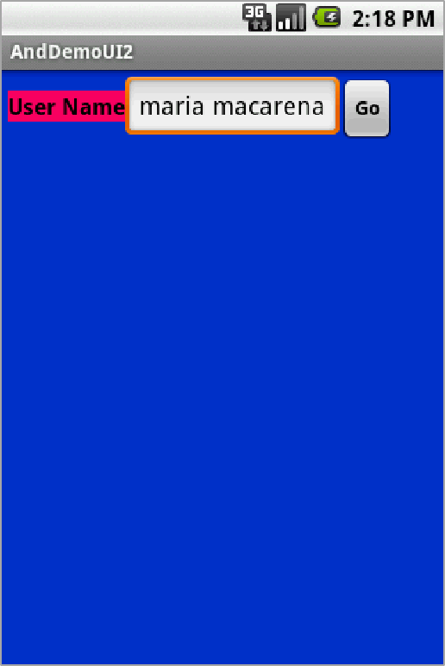
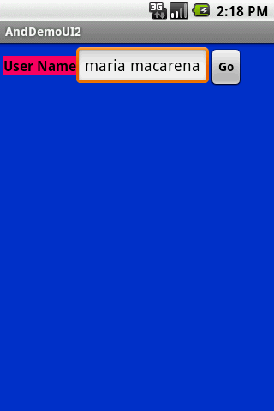
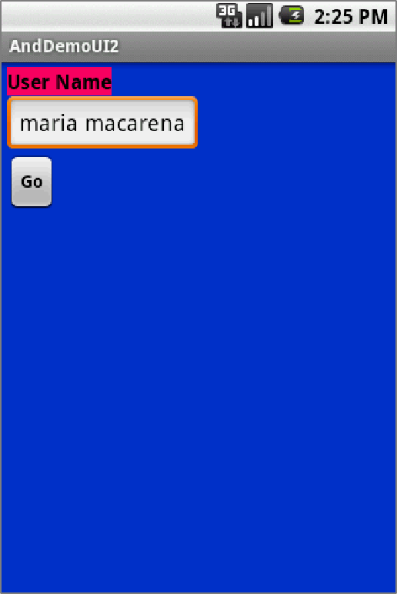
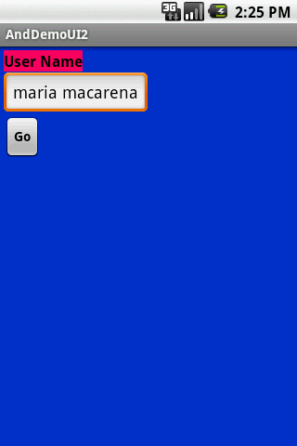
The LinearLayout - Orientation
1.1 Linear Layout: Orientation
horizontal
<?xml version="1.0" encoding="utf-8"?>
<LinearLayout
android:id="@+id/myLinearLayout" android:layout_width="fill_parent" android:layout_height="fill_parent" android:background="#ff0033cc" android:padding="4dip"
xmlns:android="http://schemas.android.com/apk/res/android"
android:orientation="horizontal" >
<TextView
android:id="@+id/labelUserName" android:layout_width="wrap_content" android:layout_height="wrap_content" android:background="#ffff0066" android:text="User Name" android:textSize="16sp" android:textStyle="bold" android:textColor="#ff000000" />
<EditText
android:id="@+id/ediName" android:layout_width="wrap_content" android:layout_height="wrap_content" android:textSize="18sp" />
<Button
android:id="@+id/btnGo" android:layout_width="wrap_content" android:layout_height="wrap_content" android:text="Go" android:textStyle="bold" />
</LinearLayout>
v e r t i c a l
20

Slide 11
The Relative Layout
Relative Layout - Referring to the container
Below there is a list of some positioning XML boolean properties (true/false) mapping a widget according to its location respect to the parent’s place.
  android:layout_alignParentTop the widget's top should align with the top of the container.
  android:layout_alignParentBottom the widget's bottom should align with the bottom of the container
  android:layout_alignParentLeft the widget's left side should align with the left side of the container
  android:layout_alignParentRight the widget's right side should align with the right side of the container
  android:layout_centerInParent the widget should be positioned both horizontally and vertically at the center of the container
  android:layout_centerHorizontal the widget should be positioned horizontally at the center of the container
  android:layout_centerVertical the widget should be positioned vertically at the center of the
container
32

Slide 12
The Table Layout
3. Table Layout
Android's TableLayout uses a grid to position your widgets.
Cells in the grid are identifiable by rows and columns.
Columns might shrink or stretch to accommodate their contents.
The element TableRow is used to define a new row in which widgets can be allocated.
The number of columns in a TableRow is determined by the total of side-by- side widgets placed on the row.
38

Slide 13
Attaching Layouts to Java Code
PLUMBING. You must ‘connect’ the XML elements with equivalent objects
in your Java activity. This allows you to manipulate the UI with code.
XLM Layout
<xml….
. . .
. . .
</xml>
JAVA code public class ….
{
. . .
. . .
}
51

Slide 14
Attaching Layouts to Java Code
Assume the UI in res/layout/main.xml has been created. This layout could be called by an application using the statement
setContentView(R.layout.main);
Individual widgets, such as myButton could be accessed by the application using the statement findViewByID(...) as in
Button btn = (Button) findViewById(R.id.myButton);
Where R is a class automatically generated to keep track of resources available to the application. In particular R.id... is the collection of widgets defined in the XML layout.
52

Slide 15
Fragment
An activity is a container for views
When you have a larger screen device than a phone –like a tablet it can look too simple to use phone interface here.
→ Fragments
    Mini-activities, each with its own set of views
    One or more fragments can be embedded in an Activity
    You can do this dynamically as a function of the device type (tablet or not) or orientation

Slide 16
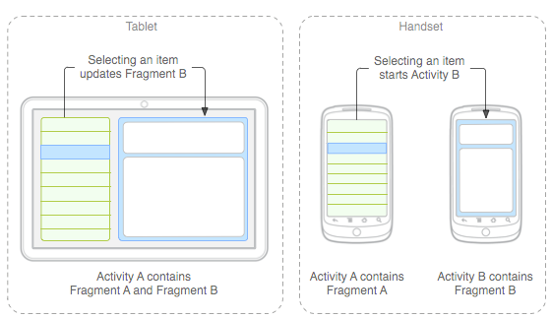
Fragment Idea
→ Fragments
    Mini-activities, each with its own set of views
    One or more fragments can be embedded in an Activity
    You can do this dynamically as a function of the device type (tablet or not) or orientation
You might
decide to run
a tablet in
portrait mode
with the handset
model of only
one fragment
in an Activity

Slide 17
Fragment
A Fragment represents a behavior or a portion of user interface in an Activity.
You can combine multiple fragments in a single activity to build a multi-pane UI and reuse a fragment in multiple activities.
You can think of a fragment as a modular section of an activity, which has its own lifecycle, receives its own input events, and which you can add or remove while the activity is running (sort of like a "sub activity" that you can reuse in different activities).

Slide 18
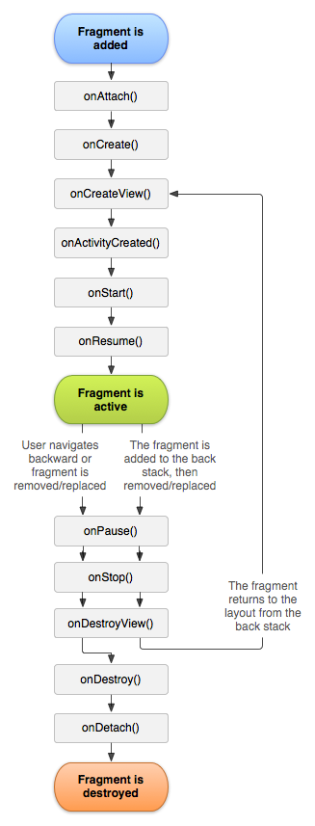
Fragment Lifecycle
Fragment in an Activity---Activity Lifecyle influences
  Activity paused → all its fragments paused
  Activity destroyed → all its fragments paused
  Activity running → manipulate each fragment independently.
Fragment transaction →add, remove, etc.
  adds it to a back stack that's managed by the activity—each back stack entry in the activity is a record of the fragment transaction that occurred.
  The back stack allows the user to reverse a fragment transaction (navigate backwards), by pressing the Back button.

Slide 19
Fragment inside Activity
it lives in a ViewGroup inside the activity's view hierarchy
fragment has its own view layout.
via XML: Insert a fragment into your activity layout by declaring the fragment in the activity's layout file, as a <fragment> element,
via CODE: from your application code by adding it to an existing ViewGroup.
you may also use a fragment without its own UI as an invisible worker for the activity.

Slide 20
Fragment – extend a Fragment class
via CODE: extend android.app.Fragment OR one of its subclasses (DialogFragment, ListFragment, PreferenceFragment, WebViewFragment )
IMPORTANT: must include a public empty constructor. The framework will often re-instantiate a fragment class when needed, in particular during state restore, and needs to be able to find this constructor to instantiate it. If the empty constructor is not available, a runtime exception will occur in some cases during state restore.
CALL Back functions (like Activity) : examples onCreate(), onStart(), onPause(), and onStop().

Slide 21
Fragment methods (callback functions)
onAttach(Activity) called once the fragment is associated with its activity.
onCreate(Bundle) called to do initial creation of the fragment.
onCreateView(LayoutInflater, ViewGroup, Bundle) creates and returns the view hierarchy associated with the fragment.
onActivityCreated(Bundle) tells the fragment that its activity has completed its own Activity.onCreaate.
onStart() makes the fragment visible to the user (based on its containing activity being started).
onResume() makes the fragment interacting with the user (based on its containing activity being resumed).

Slide 22
Fragment methods (callback functions)
As a fragment is no longer being used, it goes through a reverse series of callbacks:
onPause() fragment is no longer interacting with the user either because its activity is being paused or a fragment operation is modifying it in the activity.
onStop() fragment is no longer visible to the user either because its activity is being stopped or a fragment operation is modifying it in the activity.
onDestroyView() allows the fragment to clean up resources associated with its View.
onDestroy() called to do final cleanup of the fragment's state.
onDetach() called immediately prior to the fragment no longer being associated with its activity.

Slide 23
Fragments and their UI
Most fragments will have a UI
Will have its own layout
you must implement the onCreateView() callback method, which the Android system calls when it's time for the fragment to draw its layout. Your implementation of this method must return a View that is the root of your fragment's layout.

Slide 24
Fragments and their UI – onCreateView() using XML
Can implement onCreateView using XML
public static class ExampleFragment extends Fragment {
@Override
public View onCreateView(LayoutInflater inflater, ViewGroup container,
Bundle savedInstanceState) {
// Inflate the layout for this fragment
return inflater.inflate(R.layout.example_fragment, container, false);
}
}
Activity parent’s
ViewGroup
Bundle that provides data about the previous
instance of the fragment, if the fragment is being resumed
Have example_fragment.xml file that contains the layout
This will be contained in resource layout folder.

Slide 25
OPTION1 –adding to an Activity via Activity layout XML.
<?xml version="1.0" encoding="utf-8"?>
<LinearLayout xmlns:android="http://schemas.android.com/apk/res/android"
android:orientation="horizontal"
android:layout_width="match_parent"
android:layout_height="match_parent">
<fragment android:name="com.example.news.ArticleListFragment"
android:id="@+id/list"
android:layout_weight="1"
android:layout_width="0dp"
android:layout_height="match_parent" />
<fragment android:name="com.example.news.ArticleReaderFragment"
android:id="@+id/viewer"
android:layout_weight="2"
android:layout_width="0dp"
android:layout_height="match_parent" />
</LinearLayout>
2 fragment classes
Need unique ids for each so system can
restore the fragment if the activity is restarted

Slide 26
OPTION2 –creating and adding to an Activity via CODE.
/*Inside Activity Code where you want to add Fragment (dynamically anywhere or in onCreate() callback)
*/
//get FragmentTransaction associated with this Activity
FragmentManager fragmentManager = getFragmentManager();
FragmentTransaction fragmentTransaction = fragmentManager.beginTransaction();
//Create instance of your Fragment
ExampleFragment fragment = new ExampleFragment();
//Add Fragment instance to your Activity
fragmentTransaction.add(R.id.fragment_container, fragment);
fragmentTransaction.commit();
This points to the Activity ViewGroup in which the fragment should be placed, specified by resource ID

Slide 27
Managing Fragments
FragmentManager methods:
Get fragments that exist in Activity =
  findFragmentById() (for fragments that provide a UI in the activity layout)
  findFragmentByTag() (for fragments that do or don't provide a UI).
Pop fragments off the back stack,
  popBackStack() (simulating a Back command by the user).
Register a listener for changes to the back stack,
  addOnBackStackChangedListener().

Slide 28
Fragment Transactions – adding, removing and replacing dynamically
// Create new fragment and transaction
Fragment newFragment = new ExampleFragment();
FragmentTransaction transaction getFragmentManager().beginTransaction();
// Replace whatever is in the fragment_container view with this fragment
// and add the transaction to the back stack
transaction.replace(R.id.fragment_container, newFragment);
transaction.addToBackStack(null);
// Commit the transaction
transaction.commit();
newFragment replaces whatever fragment (if any) is currently in the layout container identified by the R.id.fragment_container
If you do not call addToBackStack() when you perform a transaction
that removes a fragment, then that fragment is destroyed when the
transaction is committed and the user cannot navigate back to it.
Whereas, if you do call addToBackStack() when removing a fragment,
then the fragment is stopped and will be resumed if the user navigates back.

Slide 29
OPTION 3- Adding Fragment that has NO UI using Code
use a fragment to provide a background behavior for the activity without presenting additional UI.
use add(Fragment, String) (supplying a unique string "tag" for the fragment, rather than a view ID).
  it's not associated with a view in the activity layout, it does not receive a call to onCreateView(). So you don't need to implement that method.
If you want to get the fragment from the activity later, you need to use findFragmentByTag().

Slide 30
Create your own Fragment class or use known sub-classes
DialogFragment Displays a floating dialog. Using this class to create a dialog is a good alternative to using the dialog helper methods in the Activity class, because you can incorporate a fragment dialog into the back stack of fragments managed by the activity, allowing the user to return to a dismissed fragment.
ListFragment Displays a list of items that are managed by an adapter (such as a SimpleCursorAdapter), similar to ListActivity. It provides several methods for managing a list view, such as the onListItemClick() callback to handle click events.
PreferenceFragment Displays a hierarchy of Preference objects as a list, similar to PreferenceActivity. This is useful when creating a "settings" activity for your application.

